Slide 1
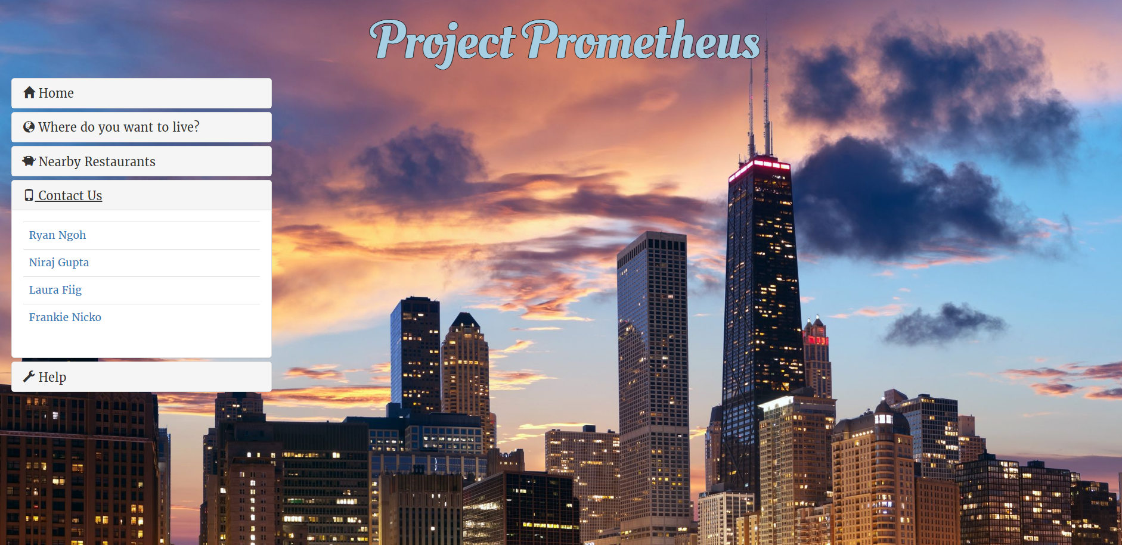

Slide 2
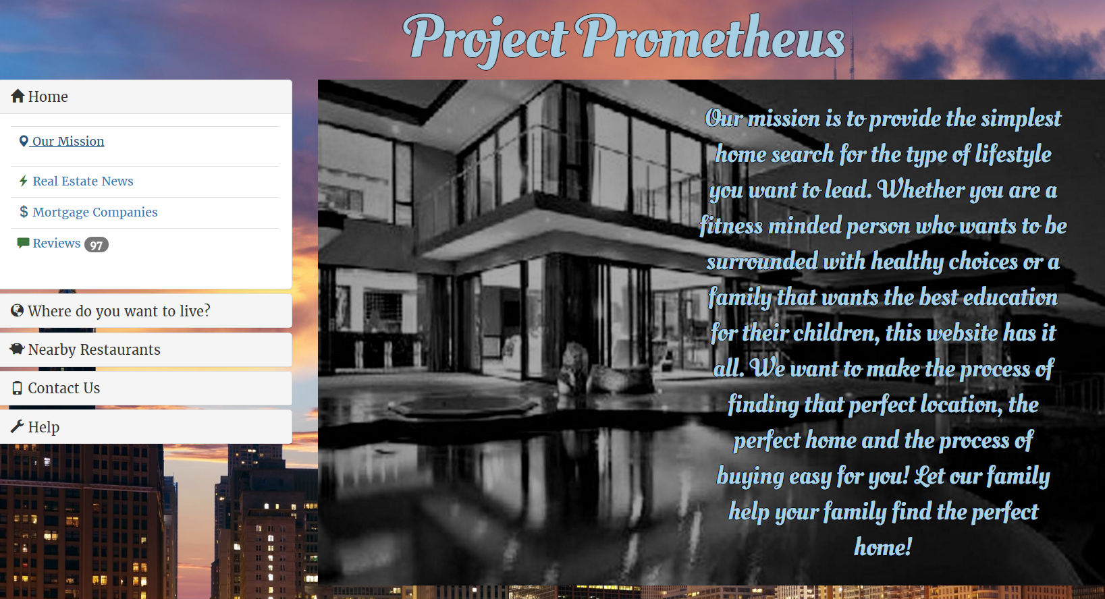
Project Prometheus
Original Goal:
Tie real estate data to neighborhood information such as restaurants, schools, trails, etc.
Issue:
MLS is not a single listing, over 1000 regional listings, with differing implementations
Services exist that normalize the data, but access is still limited to licensed realtors
Reached out to contacts, but were not able to resolve in time
Resolution:
Decided to add the neighborhood info based on the provided address and add the real estate data as an expansion

Slide 3
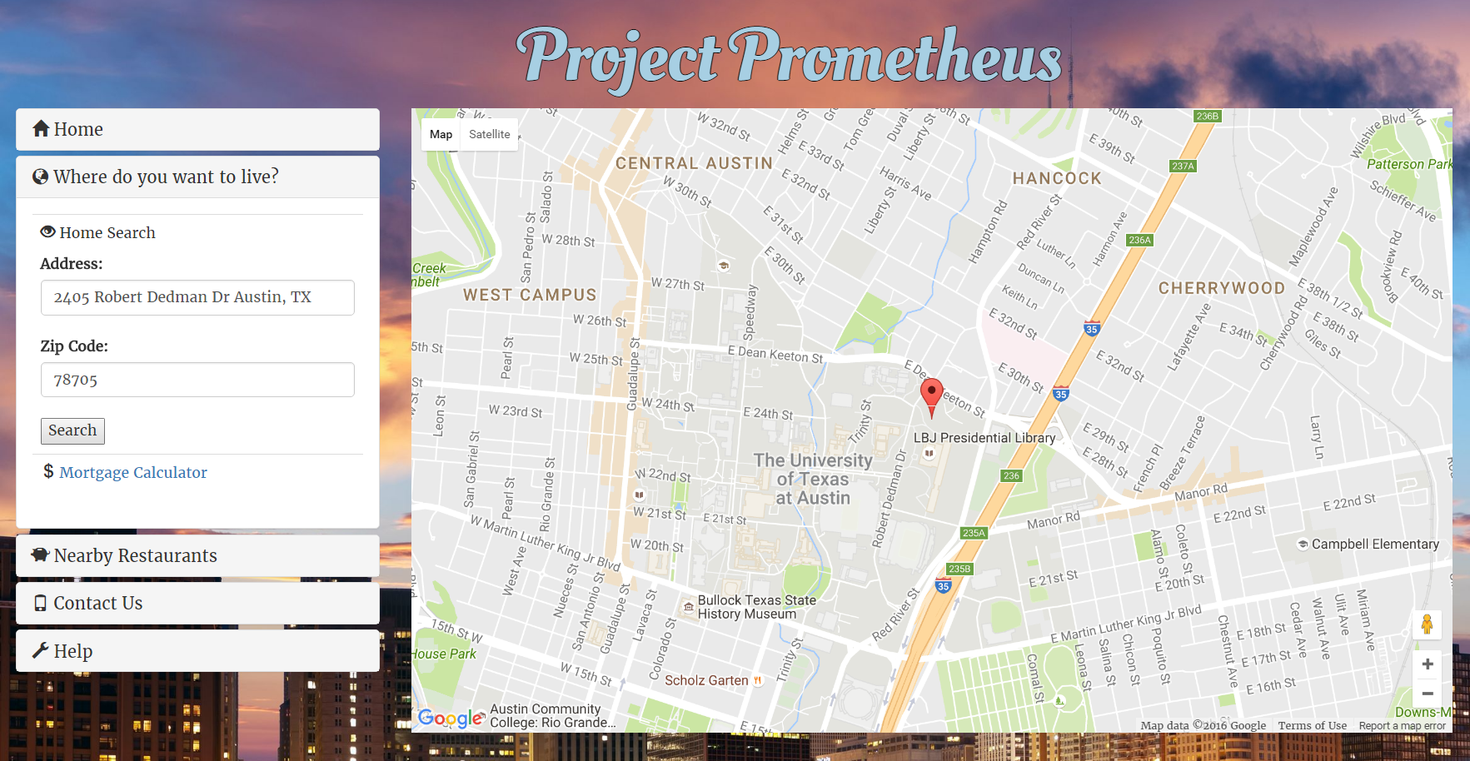
Project Prometheus
Address Mapping
Uses google API to find desired address or ZIP code and display pin on map
Future expansion – add real estate data here

Slide 4
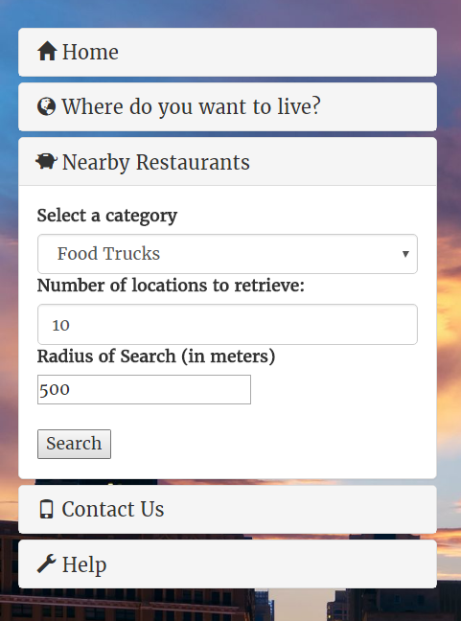
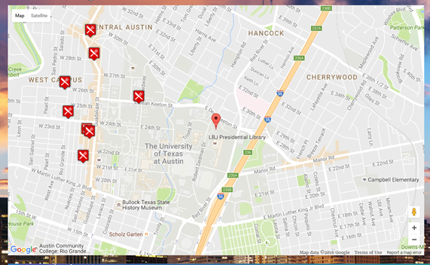
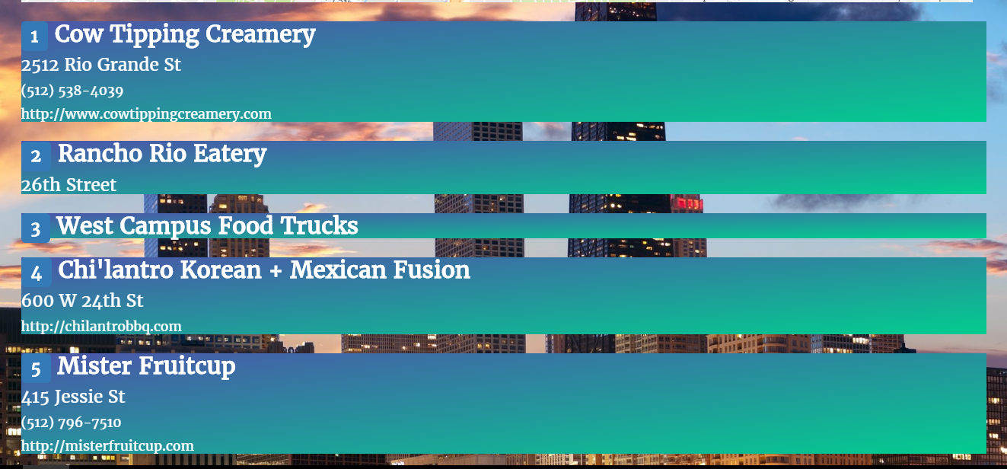
Project Prometheus
Neighborhood Info
Uses foursquare API to find local businesses and Google API to display pins on map
Businesses are grouped by different lifestyles that may interest the buyer
Additional categories can be added in future expansions
New picture here when updated →

Slide 5
Project Prometheus
Must use at least two API’s ✓✓Google, FourSquare
Must use AJAX to pull data ✓
Must utilize at least one new library or technology ✓FourSquare, Asana
Must have a polished frontend/UI ✓
Must meet good quality coding standards ✓
Must not use alerts, confirms or prompts ✓
Must have some sort of repeating element ✓
Must use Bootstrap or alternative CSS Framework ✓Bootstrap
Must be deployed ✓https://stark-plateau-41427.herokuapp.com/
Must have User Input Validation ✓??
Do we want to add
a slide about this or
about workflow?

